Slide 1
Grab The Gold!
Maneesh & pushkal

Slide 2

Home PAGE – UI

Slide 3
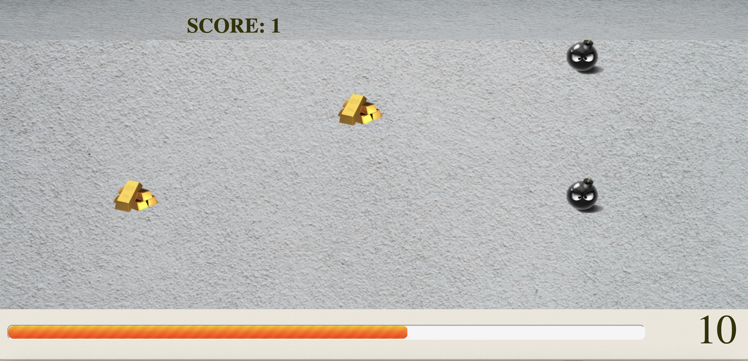
GAme UI

Slide 4
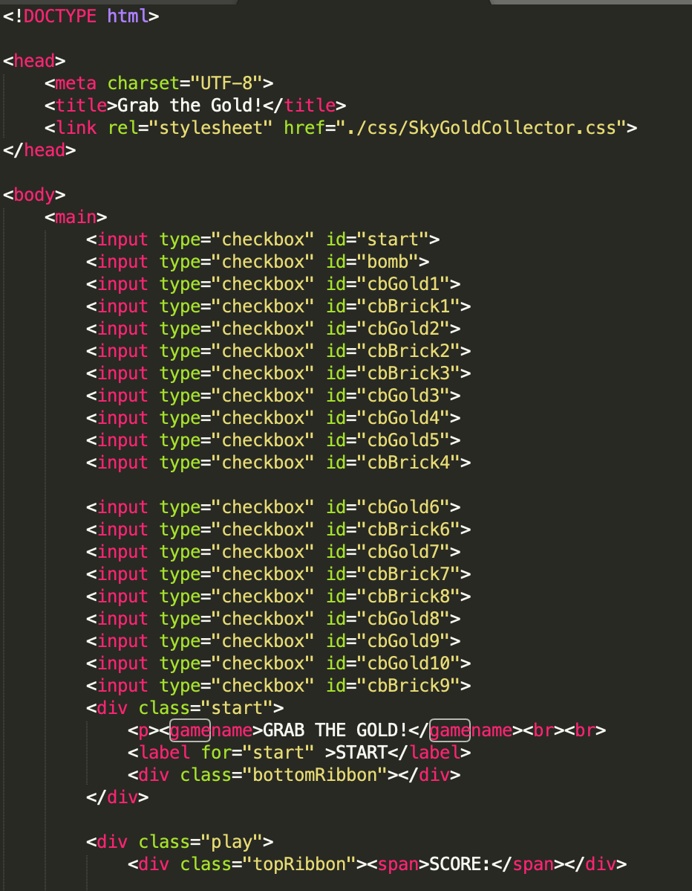
HTML code

Slide 5
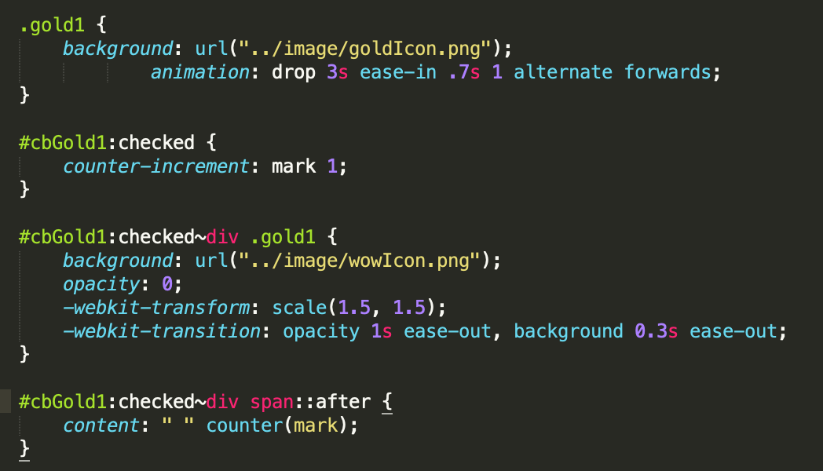
On Click -GOLD

Slide 6
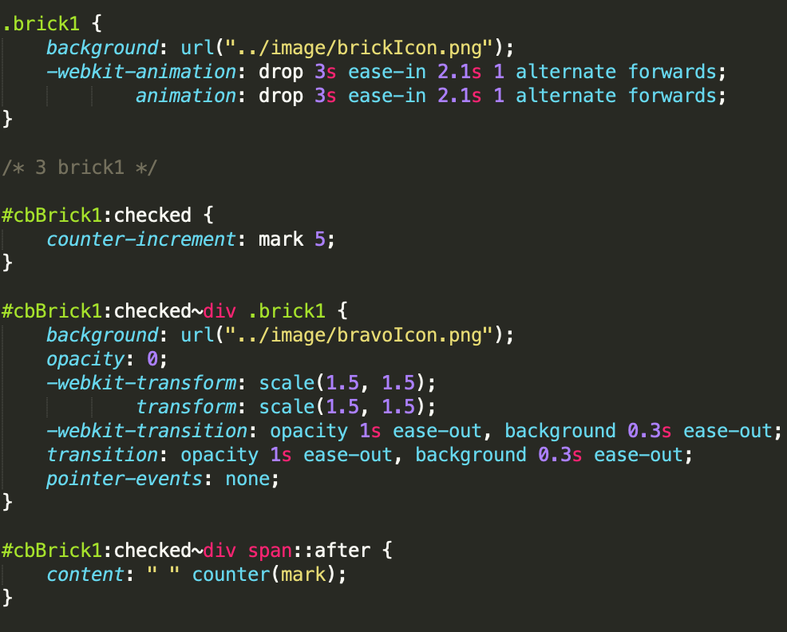
On Click – huge gold

Slide 7
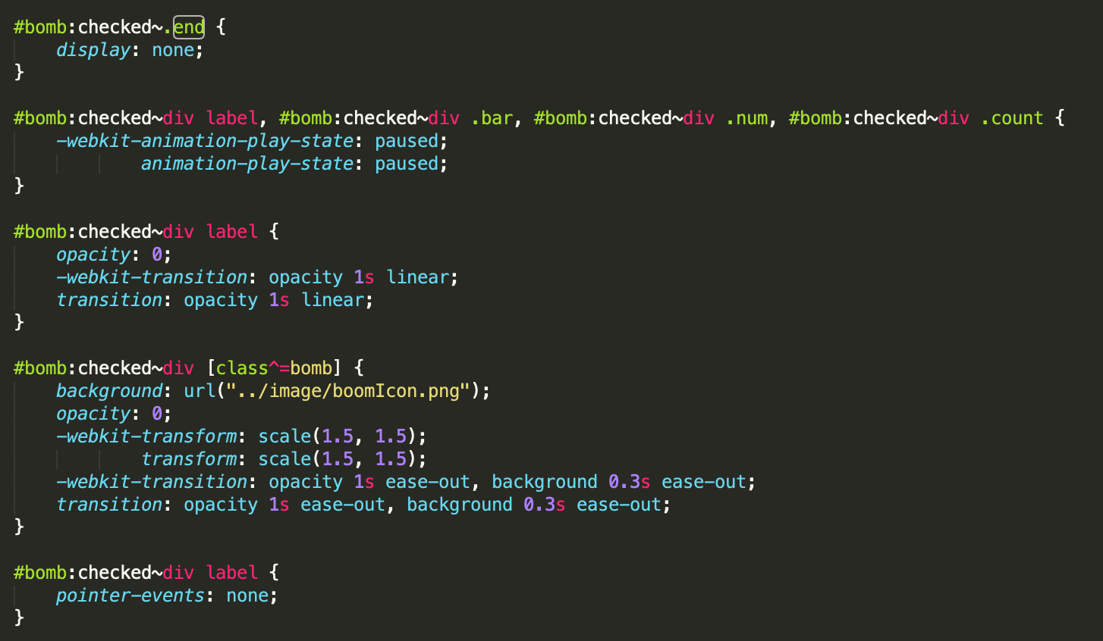
On Click -bomb

Slide 8
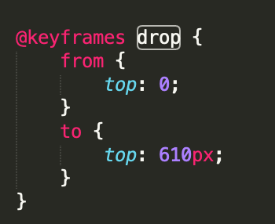
Animation for image

Slide 9
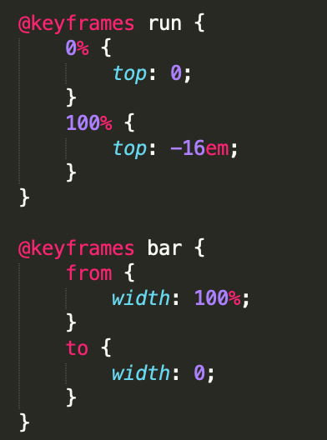
Animation for timer

Slide 10
Testing
HTML Validator
CSS Validator
Safari
Chrome

Slide 11

DEMO

